Slide 1
Personality Finder Group members:- Atiq Shaikh (59) Parag Gupta (11) Edwin James (15) Priyanshu Yadav (73)

Slide 2
Content
Abstract
Introduction
Literature Review
Proposed System
Design/Implementation
Conclusion and Future Scope

Slide 3
Abstract
This website is about finding personality of the user using Myers and Briggs personality typology. Technology used will be HTML, CSS, Bootstrap5, JavaScript and MySQL. This personality finder named as Seikaku Finder, has a test of about 40 questions designed to calculate the user’s personality. According to Myers and Briggs personality typology there are 16 personality types from which user’s personality will be determined. This research also looks at how knowing and understand your personality type can help you know yourself.

Slide 4
Introduction
Main page of our website will shown as the 16 personality typology of Myers and Briggs.
Inside the website, user will take the test to find out about their personality.
After finishing the test, user will have to put the email address to get the result in their mail.
And lastly, you can check our portfolio.

Slide 5
Literature Review
1. https://www.16personalities.com/ :
This website consists of 4 major types of personalities which further gets divides into pairs of 2 sub types of personalities. The 4 major types of personalities are Analysts, Diplomats, Sentinels and Explorers. Apart from these personalities this website include options such as toolkits and premium profile.
The tools listed in toolkits are Personal Growth, Relationship Guidance and Career Guide. The technology used to gather information and generate result is known as NERIS Type Explorer® .

Slide 6
2. https://www.personalityperfect.com/ :
The second referred website is named as Personality Perfect and contains 16 personalities type such as Inspector, Counselor, Mastermind, Giver, Craftsman, Provider, Idealist, Performer, Champion, Doer, Supervisor, Commander, Nurturer, Thinker, Visionary, and Composer. They have launched an app of their own apart from the website. This website uses Type Explorer to generate result.
3. 123test.com :
This website hasn’t much focused on finding ones accurate personality like the previous two instead of it they have focused on developing various types of such as IQ test,

Slide 7
Career test, Competency test and Assessment training. Their research staff is headed by Edwin van Thiel, PhD in Artificial Intelligence and Psychometrics, who is the co-founder and co-owner of the 123test Company. To achieve all of these goals, for the last ten years they have been using a special test development scheme that has been highly successful. It includes:
Using scientific literature as a theoretical basis for tests.
Collecting massive amounts of empirical data to ensure representative sampling.
Drawing upon the skills and experience of PhD level test developers.
Generating valid reports through 'expert systems' based on empirical findings.

Slide 8
4. https://www.sapa-project.org/ :
The SAPA Project is a collaborative research tool for studying patterns of human behavior. The test on this site will give you feedback about your personality on two levels. First, you will receive scores on the 27 personality dimensions that were identified through statistical analyses of 300,000 SAPA participants. Then we will also give you scores on the so-called Big Five factors of personality plus an overall cognition score. They are finding personality by diving it into 3 groups such as temperament, abilities and interests. To find the above mentioned category they are using International Personality Item Pool for temperament, International Cognitive Ability Resource to find abilities, & Oregon Vocational & Avocational Interest Scales for interests.

Slide 9
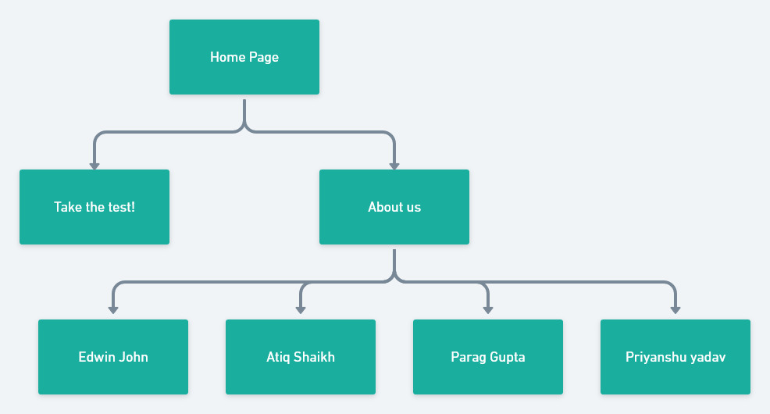
Proposed System

Slide 10
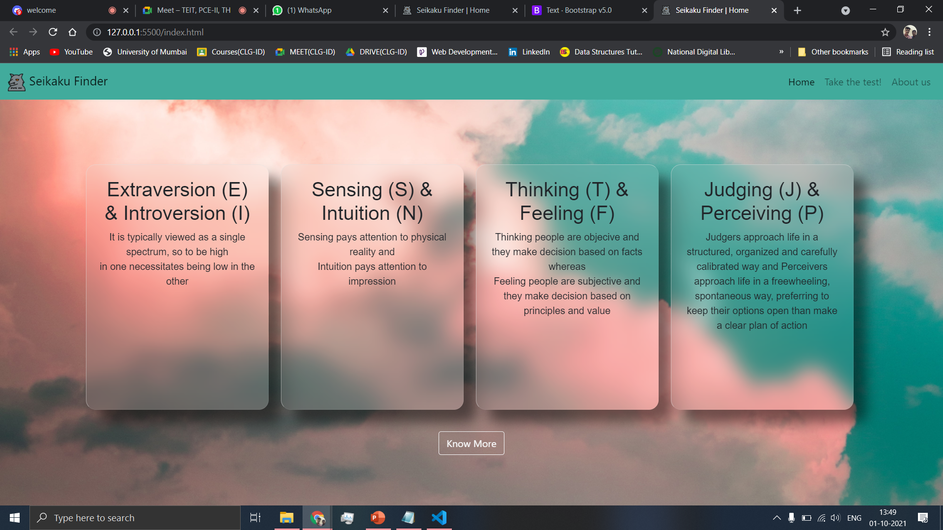
Implementation
Main Page

Slide 11
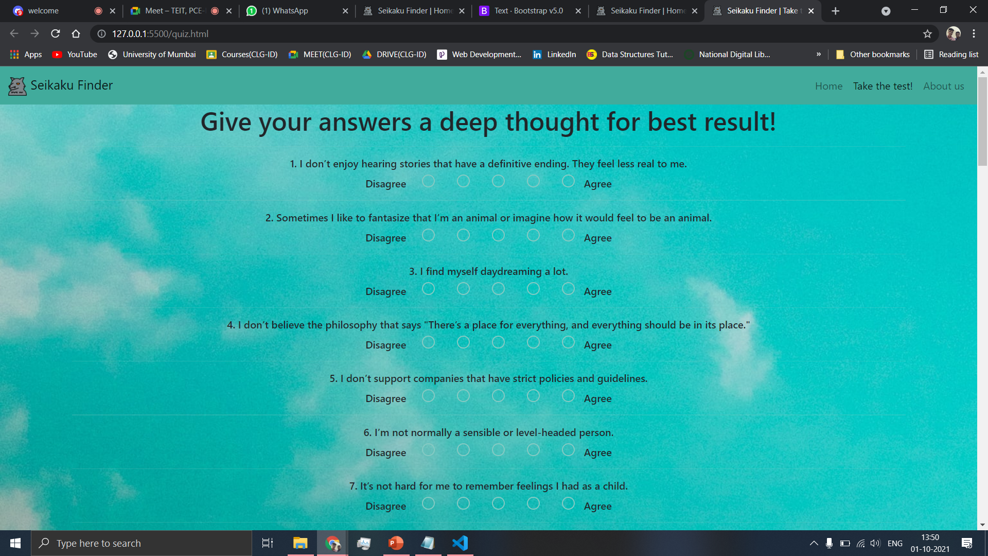
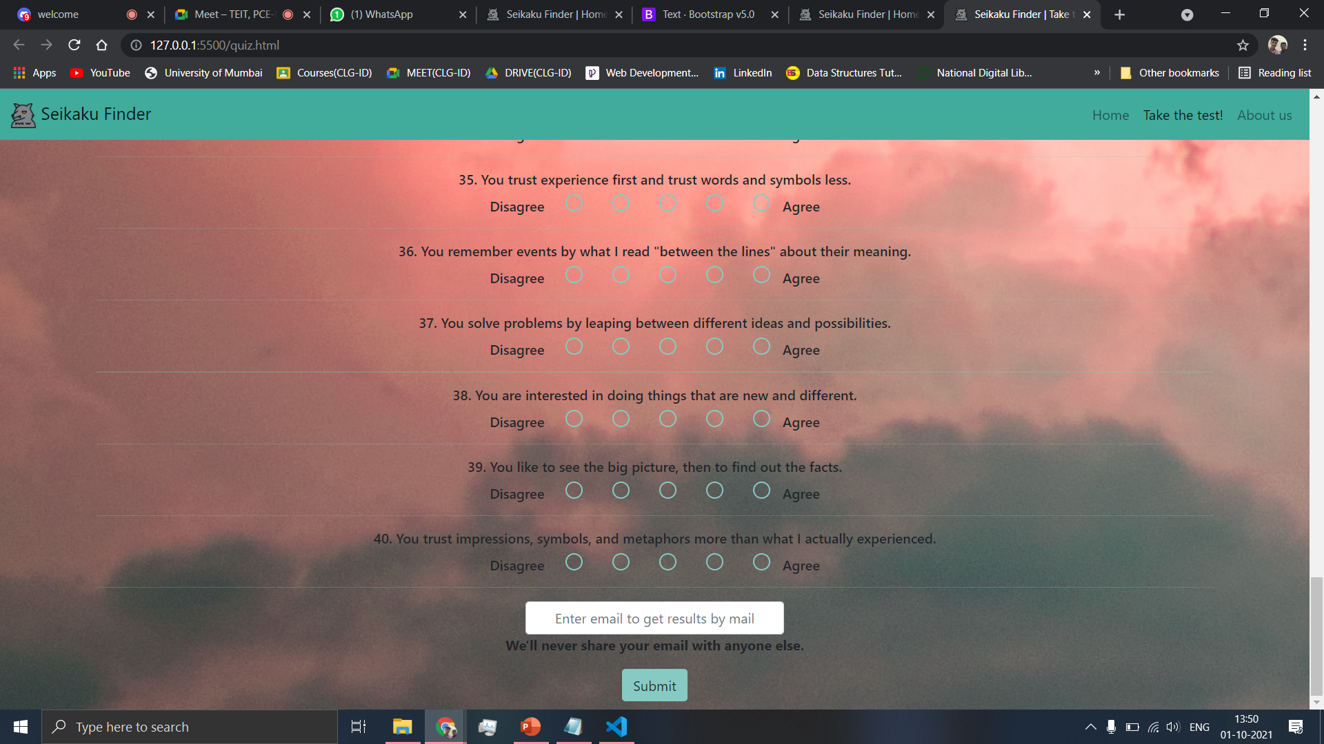
QUIZ PAGE

Slide 12
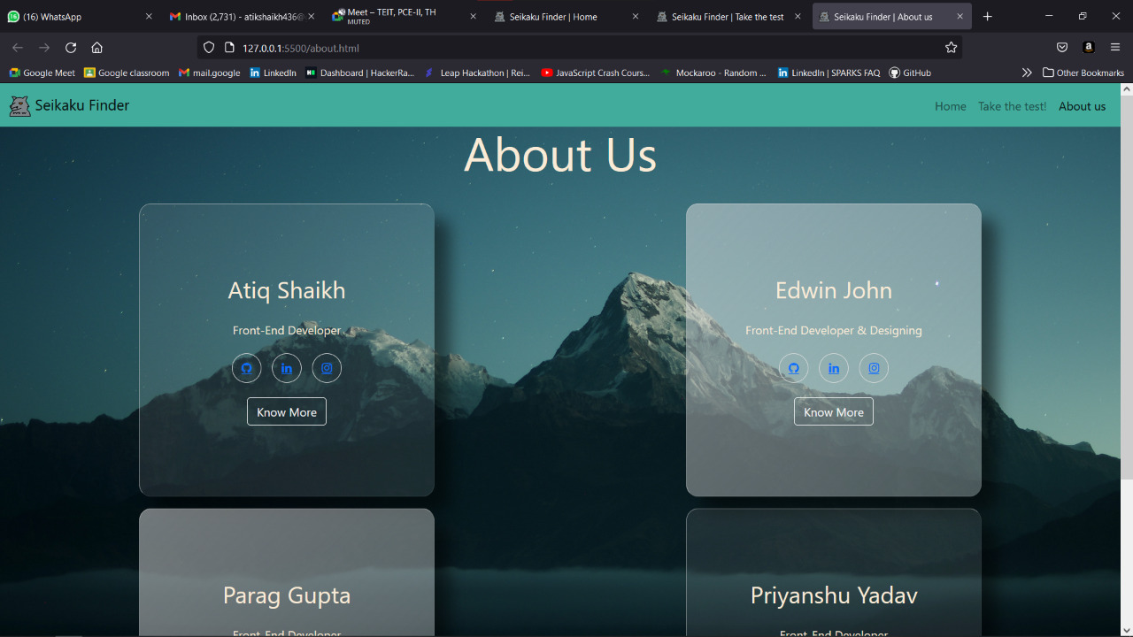
About Us Page

Slide 13
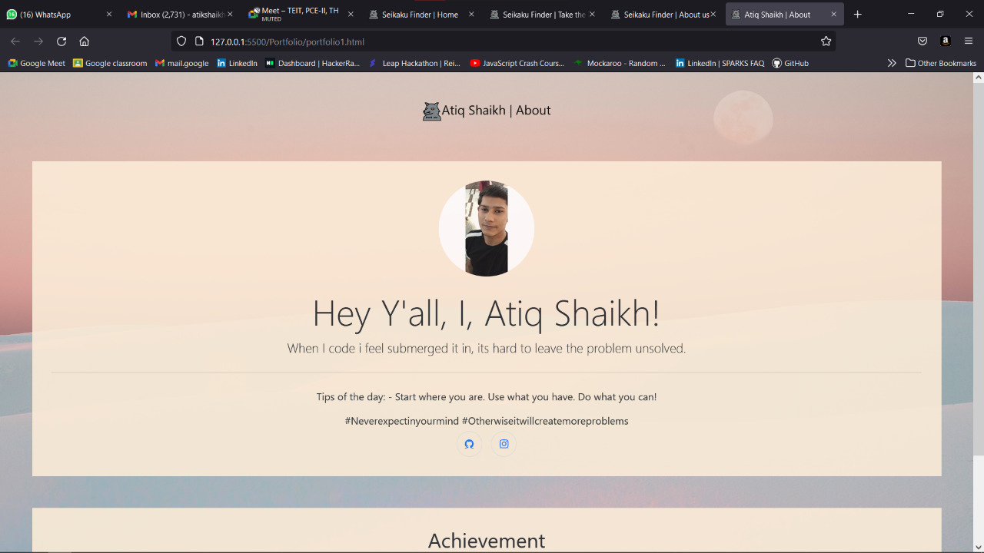
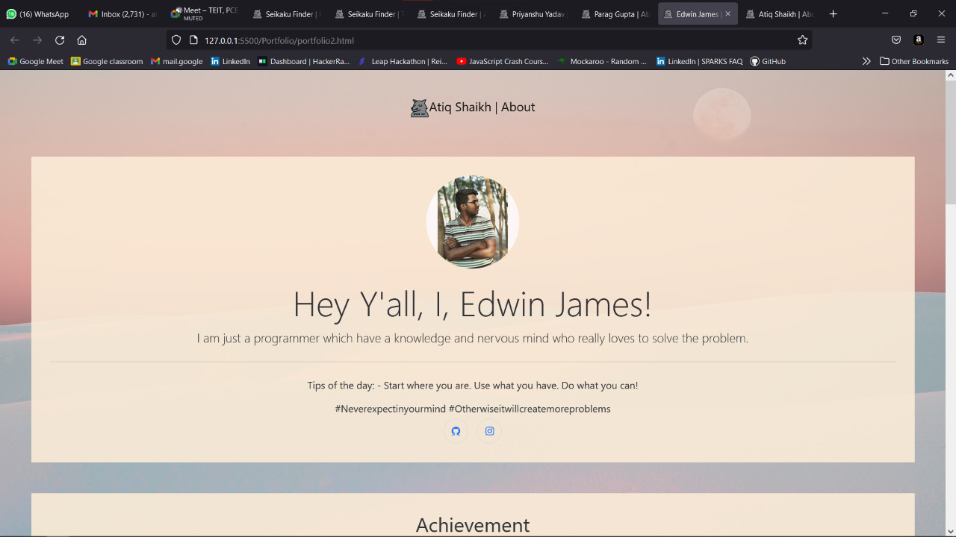
Portfolio 1
Portfolio 2

Slide 14
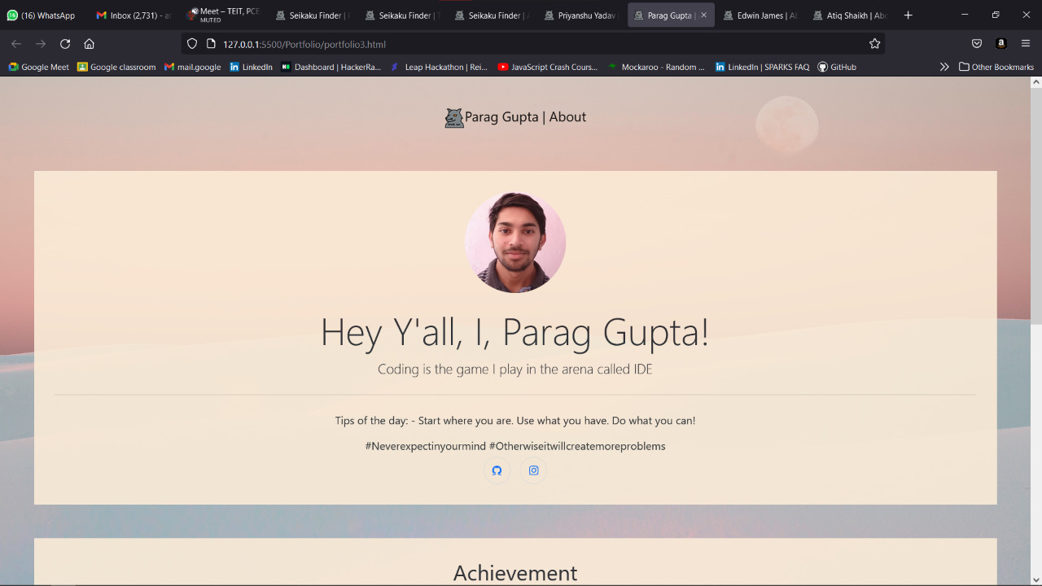
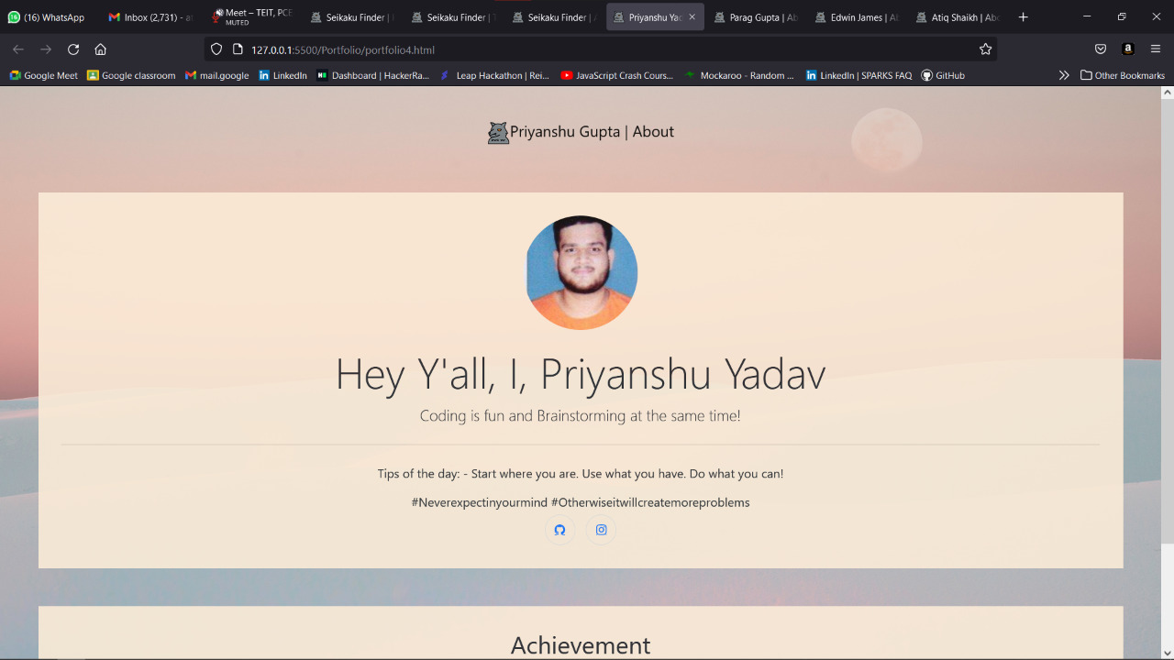
Portfolio 3
Portfolio 4

Slide 15
Future Scope
Users can identify their personality.
User can explore more of their personality.
It can reveal what skills you have and highlight your strengths.
It can help you find the best career for you.

Slide 16
Thank You!

